Slide 1

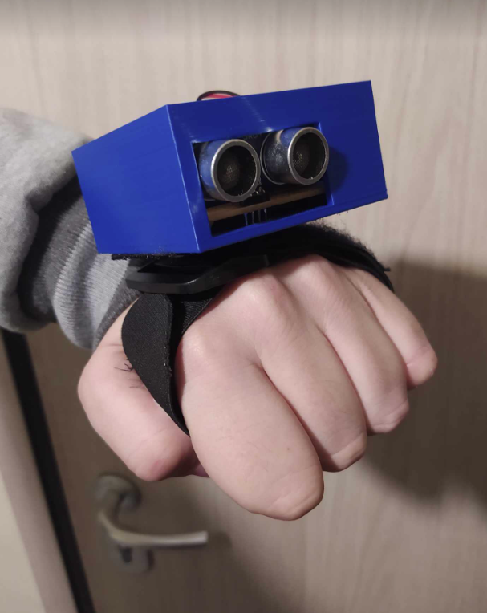
Third eye glove
Authors name – Paul Potolias
Department of Information and Electronic Engineering
Thessaloniki 54248
Email id – paulos195@gmail.com
Page 1 of 15

Slide 2
Contents
General idea……………………………………………………………………………………………………………………………... 3
Hardware ………………………………………………………………………………………………………………………………….. 4
Software ……………………………………………………………………………………………………………………………......... 7
3D print …………………………………………………………………………………………………………………………………….. 9
Result ………………………………………………………………………………………………………………………………………... 10
Characteristics……………………………………………………………………………………………………………………….…... 12
Future advancement …………………………………………………………………………………………………………….…... 13
Conclusion ……………...…………………………………………………………………………………………………………….…... 14
Page 2 of 15

Slide 3



Hardware
Software
Microcontroller
Ultra sonic module
Vibration motor module
Buzzer module
Page 3 of 15

Slide 4
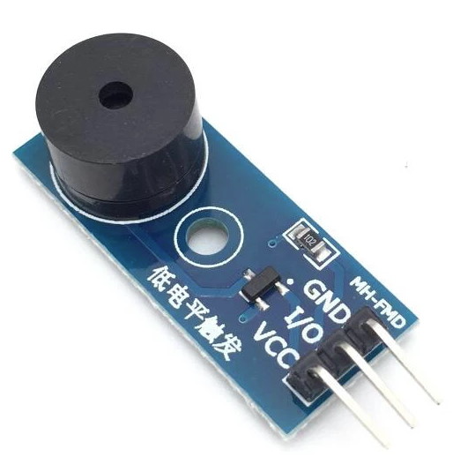
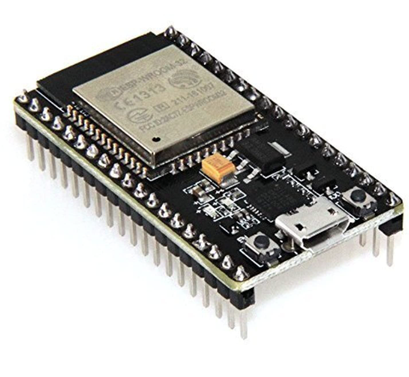
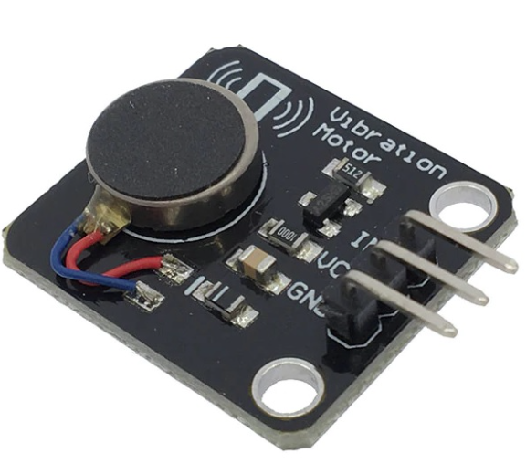
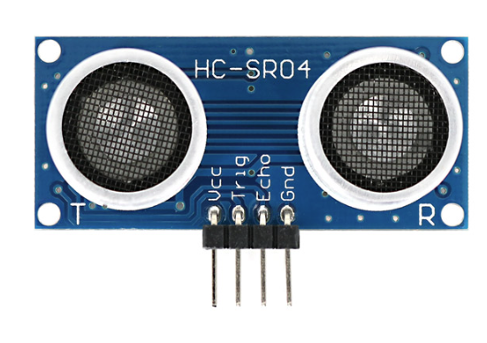
Hardware 1 of 3
Buzzer
Module
MH-FMD
Microcontroller
ESP-WROOM-32
Characteristics
Microcontroller:
Dual-core Tensilica LX6 microprocessors
32-bit architecture
Clock frequency: Up to 240 MHz
Memory:
Internal SRAM: 520 KB
Flash memory: 4 MB
Peripheral Interfaces:
GPIO (General Purpose Input/Output) pins
I2C, SPI, UART, I2S, PWM
ADC (Analog-to-Digital Converter)
Operating Voltage:
2.2V to 3.6V
Vibration
module
R2215
Ultra sonic
Module
HC-SR04
Page 4 of 15

Slide 5
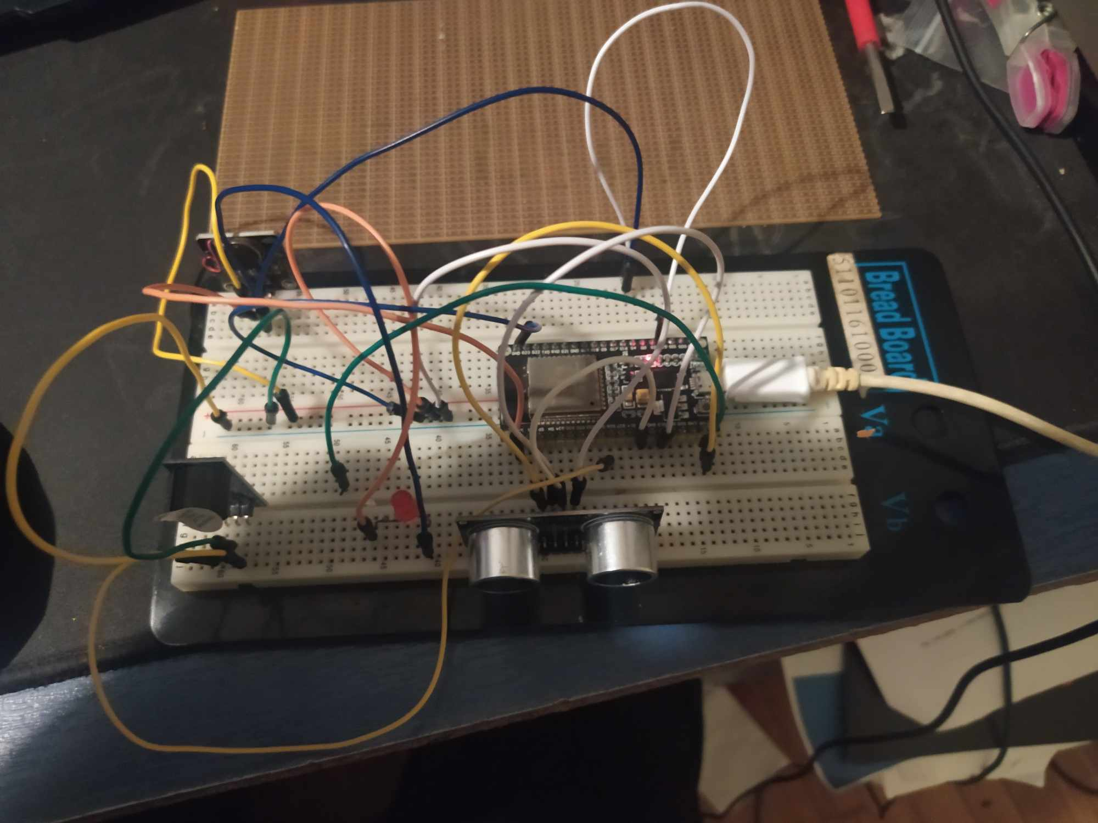
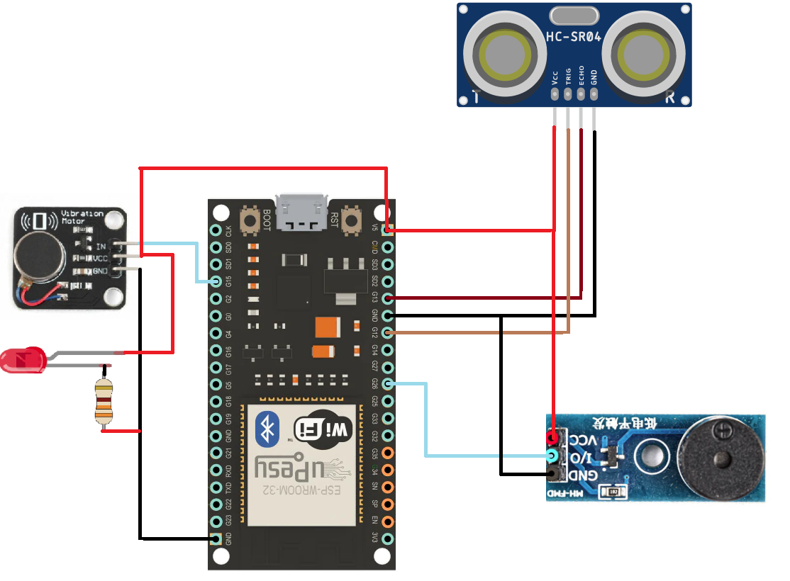
Hardware 2 of 3
Page 5 of 15

Slide 6
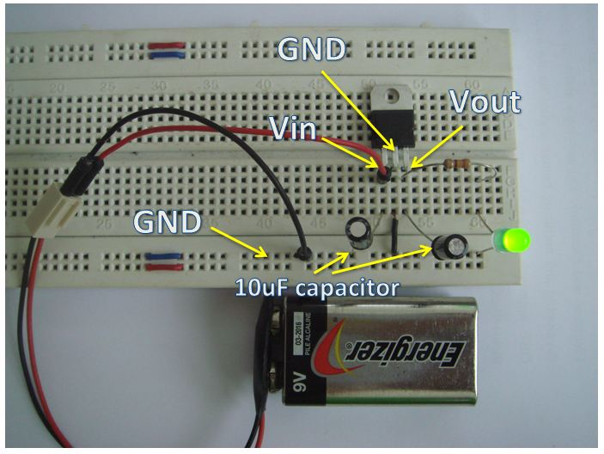
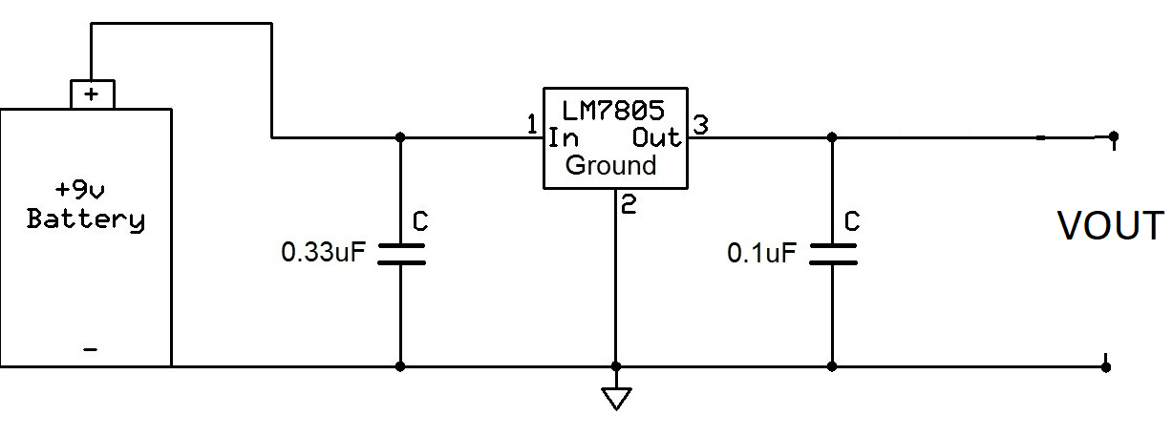
Hardware 3 of 3
Page 6 of 15

Slide 7
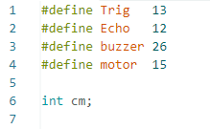
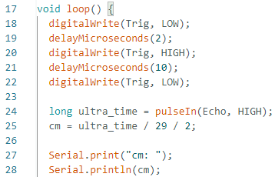
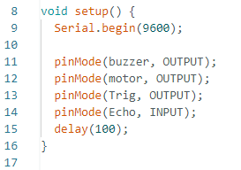
Software 1/2
Constants and Variables
Loop Function
Setup Function
Powered by
Page 7 of 12

Slide 8
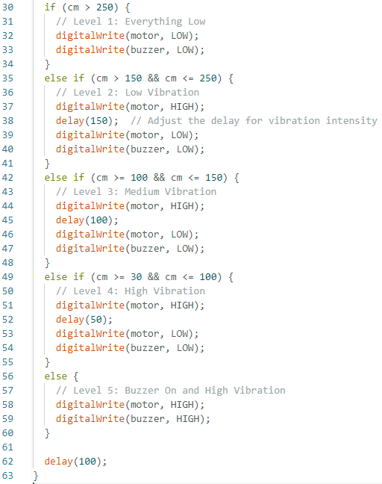
Software 2/2
Level 0
vib off
CM > 250
Level 1
vib on
CM > 150 < 250
Level 2
2 vib on
CM > 100 < 150
Level 3
3 vib on
CM > 30 < 100
Level 4
4 vib on
Buzzer on
Powered by
CM < 30
Page 8 of 15

Slide 9
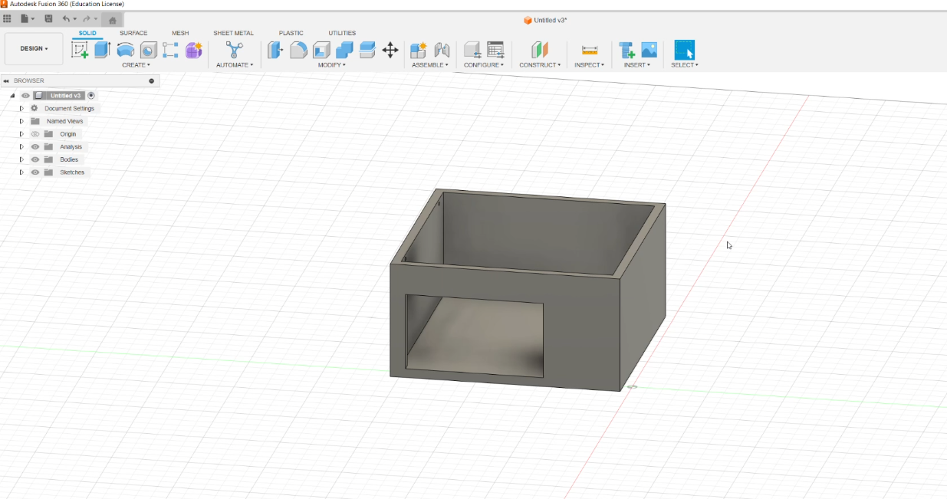
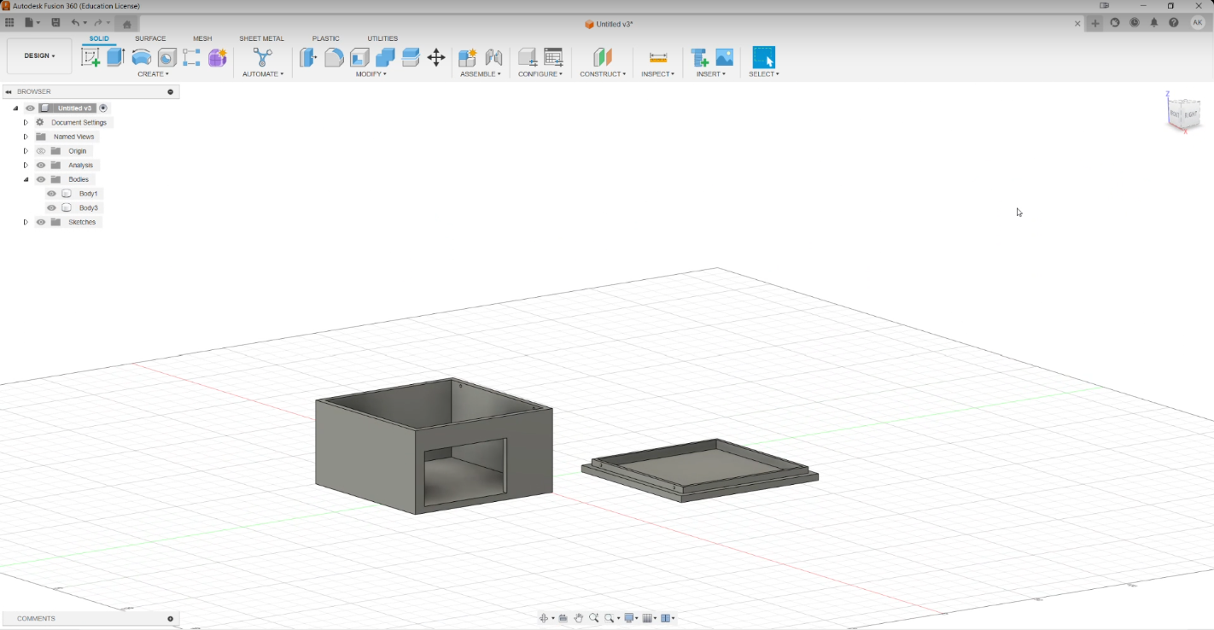
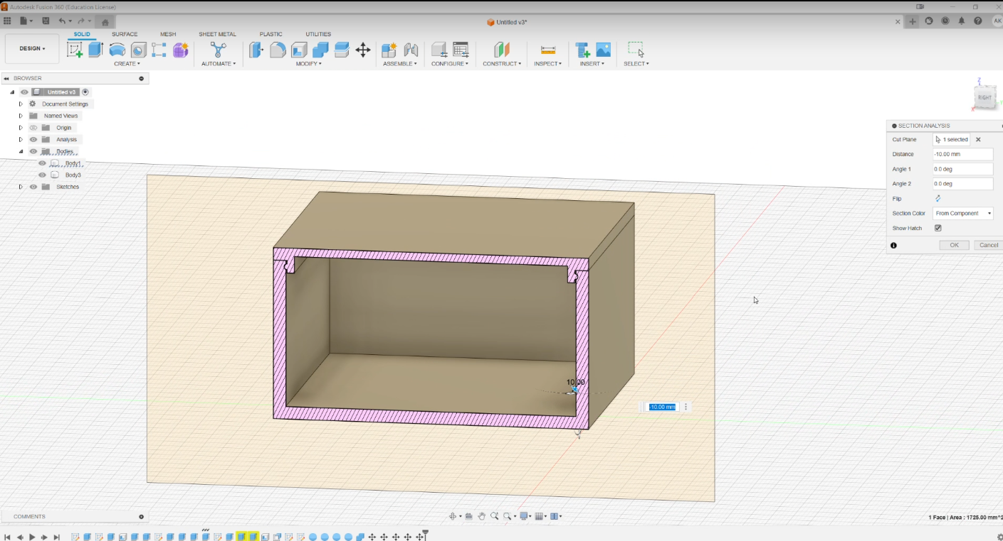
3D Printed case
Page 9 of 15

Slide 10
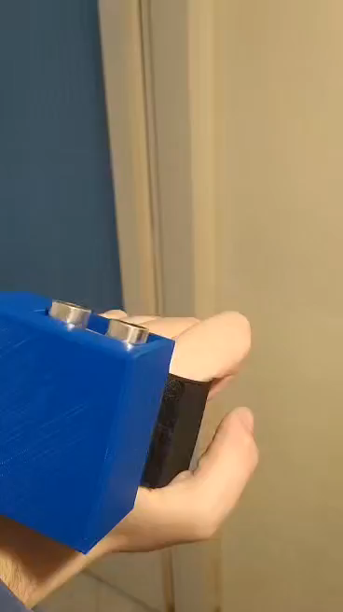
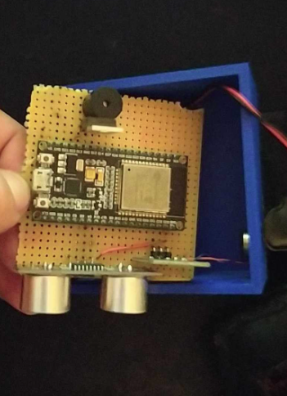
Page 10 of 15

Slide 11
Page 11 of 15

Slide 12
Consumption
Idle
Vibration
Vibration-buzzer
mA | Uptime hours
50.65 | 10.6
mA | Uptime hours
60 | 10
mA | Uptime hours
106 | 5.6
Watt/hour | η (LM7805)
0.2528 | 89.3%
Watt/hour | η (LM7805)
0.3 | 85.9%
Watt/hour | η (LM7805)
0.530 | 74.92%
Typical alkaline 9v battery has 500 mAh at 100 mA discharge rate, or about 4.5W
Page 12 of 15

Slide 13
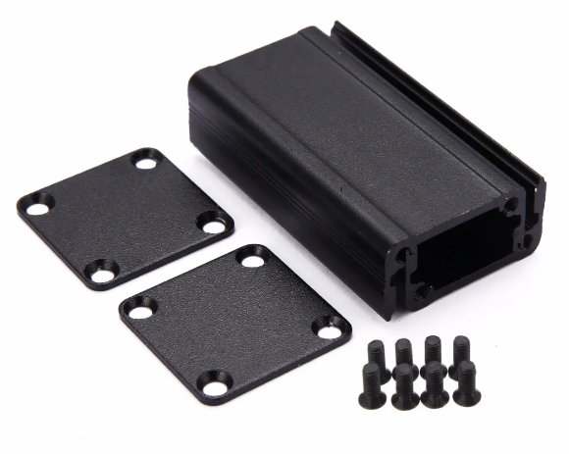
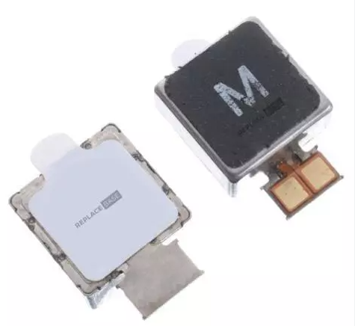
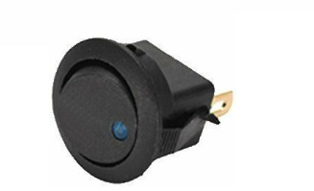
Future Advancements
On off button
Better vibration module
Better case
Page 13 of 15

Slide 14
Summary
The project incorporates the principles of ultrasonic distance sensing and employs the Arduino platform for real-time data processing. It provides a tangible example of how Arduino and sensor modules can be combined to create a practical solution for distance monitoring, potentially serving as a "third eye" in applications such as obstacle detection or proximity sensing to help people with disabilities.
Page 14 of 15

Slide 15

ANY QUESTIONS?
Page 15 of 15

